Slide 1

Visual Studio
For Hackathon 2019
By William M Mortl, Amanda Kaufman, Mark Bishop, Shruti Pathak, Devanshi Patel, and Craig Riter

Slide 2
Cloud Computing – The Good
Cloud computing promises to make developing apps at scale easier
Deploy and leave it up to ”the experts” to manage the infrastructure
Existing apps in private data centers can be ported to Azure

Slide 3
Cloud Computing – The Bad
Current distributed application developers that use Microsoft technologies struggle to adapt to Azure
Developers are familiar with using MMC snap-ins to manage Windows Server infrastructure – Azure doesn’t have similar management tools and patterns

Slide 4
Cloud Computing – The Ugly
Arcane command line incantations via the Azure CLI
YAML is not intuitive
ARM templates are impossible to memorize the structure of
Repurposing old YAML and ARM, which leads to…
Typos 🤮

Slide 5
Microsoft’s Mission & Azure
Microsoft’s corporate mission is to empower every person and every organization on the planet to achieve more
For Azure to achieve this lofty ideal, a better developer experience is needed

Slide 6
The Solution?
Create a visual design tool for Azure which adopts time-honored Microsoft visual design metaphors
Draw your Azure infrastructure
Configure infrastructure properties like you would configure elements of a Windows form
Export industry-standard config files & scripts

Slide 7
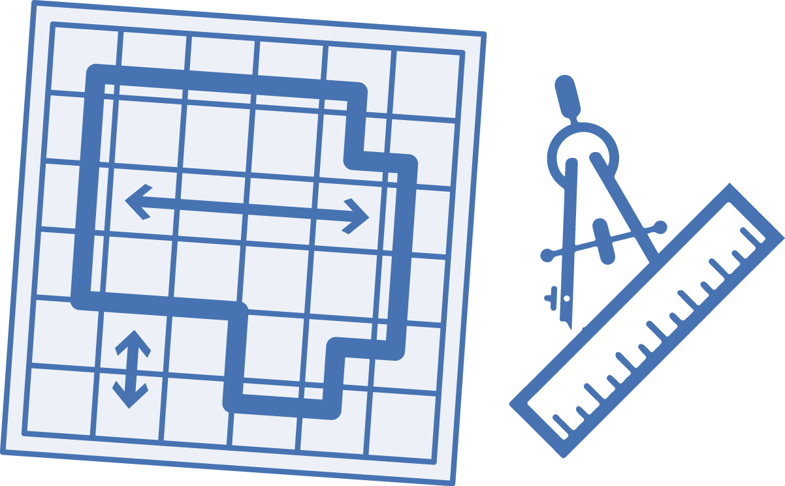




Visual Azure Studio - Workflow
ARM
Visual Azure Studio
ARM
Terraform
Import
or
YAML
Create schematic
.ps1
.sh
or
Execute script
Resources created

Slide 8
Visual Azure Studio – Hackathon Preview
Demo

Slide 9
Going Forward…
Invest more time in a full, modern, and robust application
Build Visual Azure Studio using the electron application framework, this ensures…
Multi-platform: Windows, Linux, and Mac

Slide 10
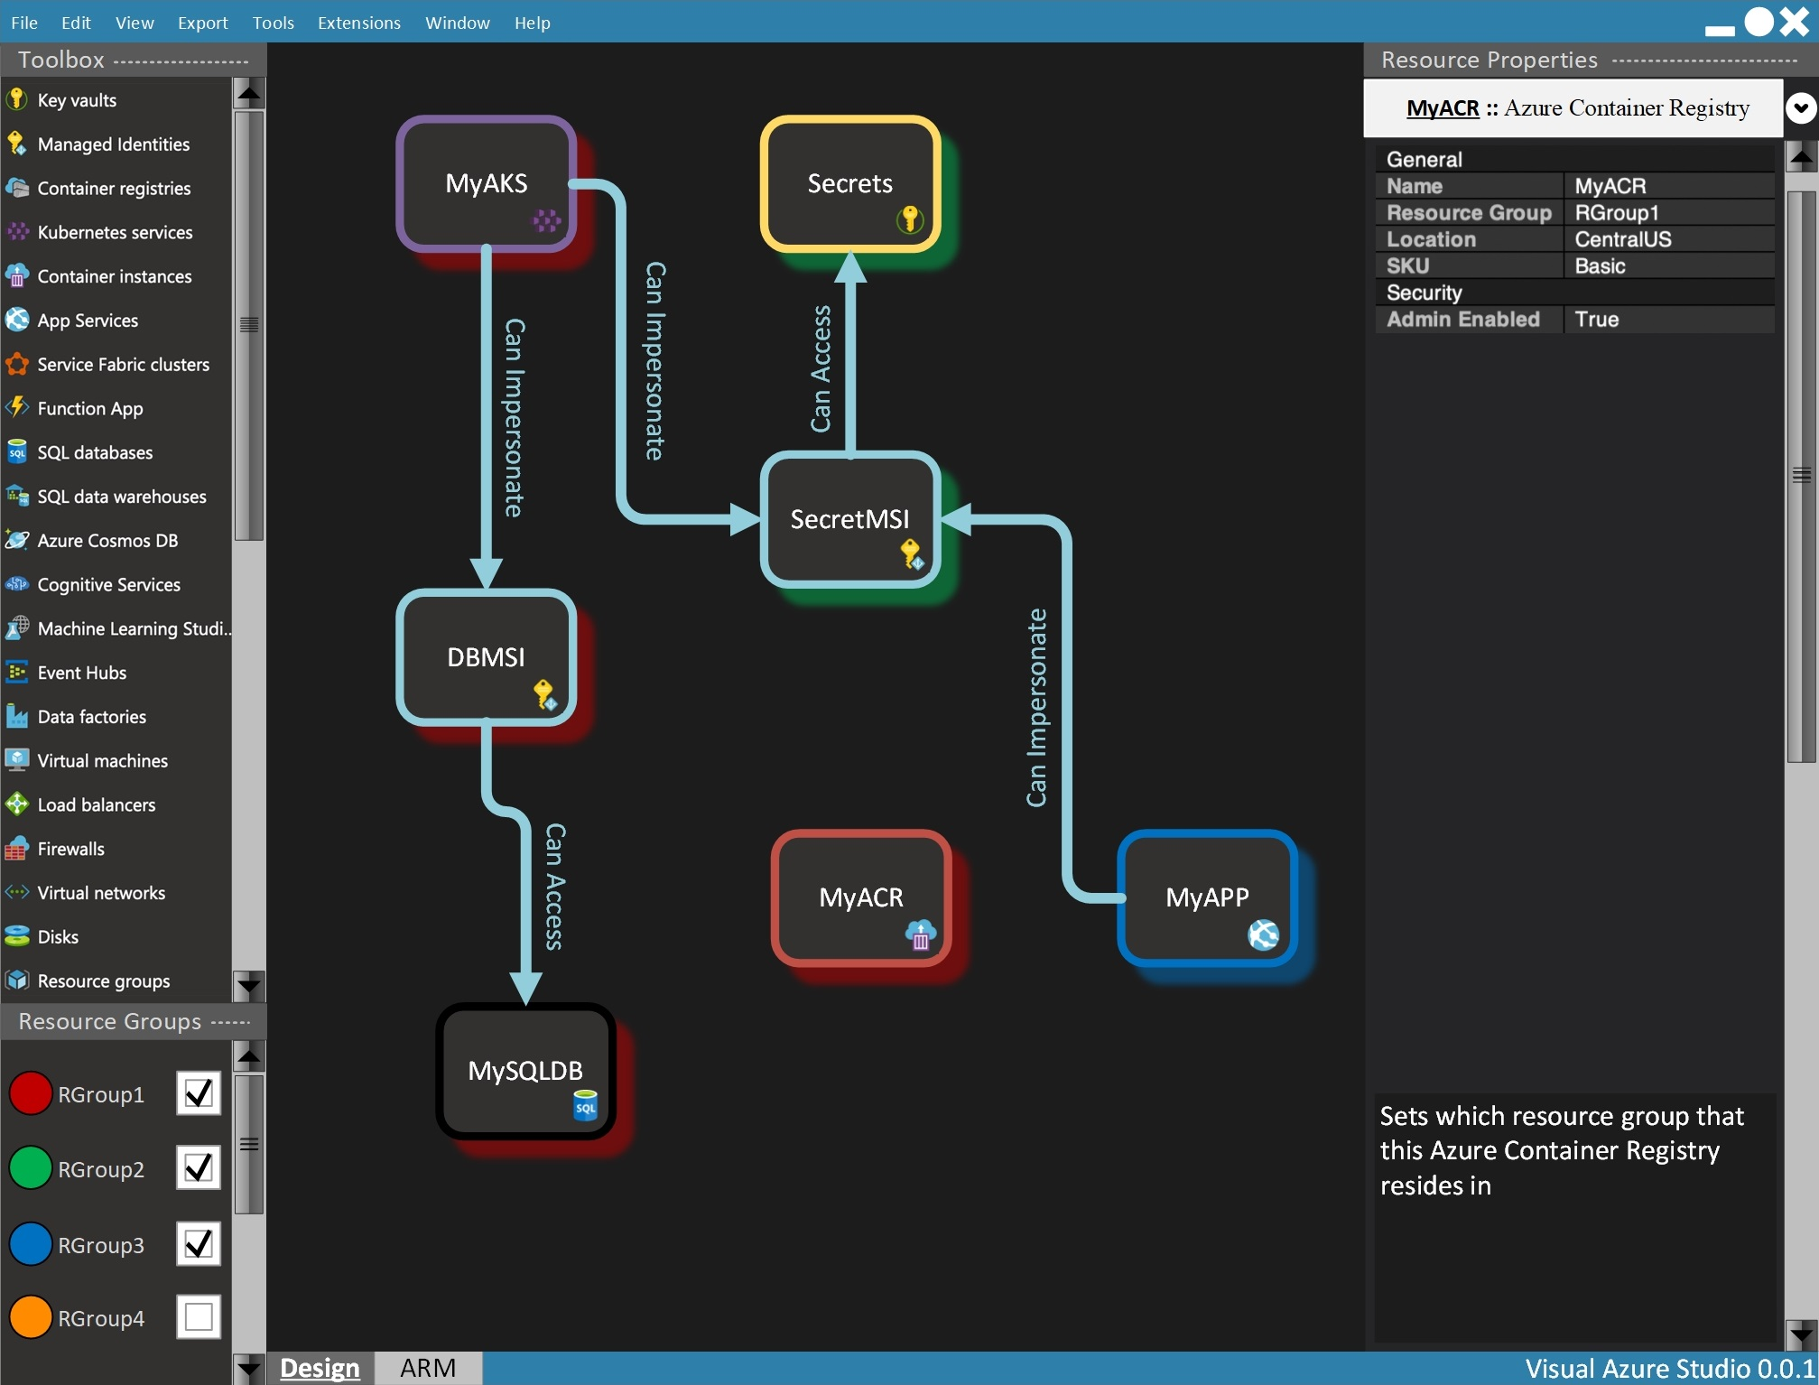

Slide 11
Thank You!
Thank you from the whole Visual Azure Studio Hackathon 2019 team!
William M Mortl
Amanda Kaufman
Mark Bishop
Shruti Pathak
Devanshi Patel
Craig Riter
https://github.com/williammortlmicrosoft/visualazurestudio

